Slide 1
AI R&D: Beyond Arts Funding

Slide 2
Who we are
Formerly part of Nesta, we are an independent not-for-profit finding imaginative ways to grow the cultural and creative sectors’ financial resilience and social impact.
What do we do?
Provide impact investment – our Arts & Culture Impact Fund makes loans of £150k - £1m to cultural organisations with social impact
Convene conversations around cultural business models, impact and innovation
Provide advisory services around impact and investment in the arts
Figurative.org.uk

Slide 3
Today’s speakers
Oonagh Murphy, Responsible AI Fellow, Arts Council England
Emma Cooper, Knowledge Transfer Manager, Creative Industries, Innovate UK Business Connect
Jesse Ringham, Founder and Creative Director, Jesse James Agency
Nema Hart, Director of Inclusive Innovation, Arts Council England

Slide 4
AI Reference
Group
December 2024

Slide 5
AI Reference Group
Act as a community of practice
A hierarchy free space
Sense check approach to AI at ACE
Bring emerging Q’s and challenges to the group for discussion
Be a critical and curious space to exchange ideas

Slide 6
Something interesting:
Dr Bronwyn Jones
AI @ BBC
Today
Sense checking:
Staff guidance, public position statement updates. What resources do you need?
Your insights & experience: Opportunities to share your insights

Slide 7
DR BRONWYN JONES
Bronwyn Jones is a social science researcher and journalist who splits her time between researching data and artificial intelligence (AI) in news production and reporting for BBC News.
She is interested in understanding the implications of emerging data-driven technologies for media and communications and contributing to the design of public interest-driven socio-technical systems.

Slide 8
Public Position Statement
AI in Grantmaking Processes
Updates
Whitelist
A list of platforms and tools ACE is comfortable with staff using
Staff Guidance
A simple and instructive guide to support staff and enable responsive use of appropriate tools

Slide 9
Draft Public Position Statement
Adoption of Generative AI across our everyday lives has meant that Arts Council England has been asked by the sector to outline their approach to the use of this technology in the writing and assessment of funding applications.
We recognise that these technologies may help to streamline the funding application process for applicants. However, ensuring confidentiality, protecting intellectual property and maintaining the integrity of your artistic and cultural vision is of the utmost importance to Arts Council England. Similarly, the integrity of the application’s assessment and decision-making process is critical in ensuring a fair, transparent and equitable process.
As such, assessment of Arts Council England funding applications is carried out by Arts Council staff, who are experts in their field. We do not use AI technologies in the assessment and decision making of applications.
While the use of these tools brings potential benefits in the writing of funding applications, and in supporting the writing of reporting documents, we advise against overreliance. Where an individual funding call has specific requirements around the use of AI, these will be explicitly stated.
Generative AI tools create potential risks around bias, transparency, data protection and the moral and legal rights of creators. It is important, therefore, that the sector employs these tools in a way that aligns with existing data protection policies, and organisational values. We are also increasingly aware that the increased use of these tools lead to applications with a similar language and text, which can distract from each application’s unique proposition.
We also advise applicants to be cautious of using systems that retain your information for the purpose of training a commercial technology companies' model. You can find out how your data is used by reading the terms of service of individual AI Tools. Enhanced data protection is often, though not always, provided by paying a licence fee.
We know that technologies change over time, and as such our guidance must respond to these changes. This high-level statement is designed to provide guidance to the sector at this moment in time and will be reviewed as required by Arts Council England as it continues to convene and support the sector to develop its own policies and practices.

Slide 10
A list of platforms and tools that ACE is comfortable with staff using, with clear use cases, designed for a non technical reader. With signposting to an approval process for use beyond this list.
Whitelist

Slide 11
STAFF GUIDANCE
49 comments and replies from staff reference group

Slide 12
Public position statement approved by Investment Directors - 18th December
Public Position Statement
AI in Grantmaking Processes
Whitelist of tools by end of December/Jan
Final staff guidance appoved by Director New Tech and Innovation
Whitelist
A list of platforms and tools ACE is comfortable with staff using
Public position statement, whitelist and staff guidance brought to AI Oversight group - 21st Jan
Staff Guidance
A simple and instructive guide to support staff and enable responsive use of appropriate tools
Public position statement and Staff Guidance - brought to EB - 13th Feb

Slide 13
Recomendations
SOMETHING INTERESTING
Develop Internal AI Policy: for staff.
Create a public position statement: on the use of AI in grant making.
Track software Licences: a record of licences that have been bought.
Support upskilling opportunities: comprehensive AI training offer for staff
Pilot programs: explore AI implementation in an organisation specific context.
Establish a Governance Structure: oversee AI policy implementation.
Sector Support and Mapping: engage stakeholders to Map the impact of AI.
Contribute to public discussion: inform policy and debate.

Slide 14
OurPlace
What information and resources would be helpful for you and your colleagues?
Breakout room discussion
Prepare key points to share with group

Slide 15
SHARING YOUR INSIGHTS
YOUR INSIGHTS & EXPERIEMCE
WHAT WE ARE READING WATCHING LISTENING TOO
HTTPS://ARTSCOUNCILENGLAND.SHAREPOINT.COM/:W:/R/SITES/AUDIENCEINSIGHTINNOVATION/_LAYOUTS/15/DOC.ASPX?SOURCEDOC=%7BFE35AEB3-3C0C-4A52-A680-FC6F07E361A6%7D&FILE=WHAT%20WE%20ARE%20READING%20WATCHING%20LISTENING%20TO%20(AI).DOCX&ACTION=DEFAULT&MOBILEREDIRECT=TRUE
NOTEBOOK LM
OTHER EXAMPLES
Luke Burton
https://artscouncilengland.sharepoint.com/:w:/s/AudienceInsightInnovation/EQgD0jSOTWBGnkiZG0tbfB8Babl6dqGPmtTzt-3uR2a2sQ?e=1g96c6

Slide 16
Something interesting - guest speakers - we are open to suggestions.
Next Time
Sense checking - Pilots
Your insights & experience - what questions, ideas, challenges, examples do you want to share and discuss?

Slide 17
Thank You
keep in touch - as a team myself, Paul, Owen and Lydia are happy to answer questions and support your work and learning in this area.
Do share links, ask questions and reach out. We want this to be a space for learning, so I’m always happy to jump on a call, and am open to ideas and suggestions for future meetings.
oonagh.murphy@artscouncil.org.uk

Slide 18
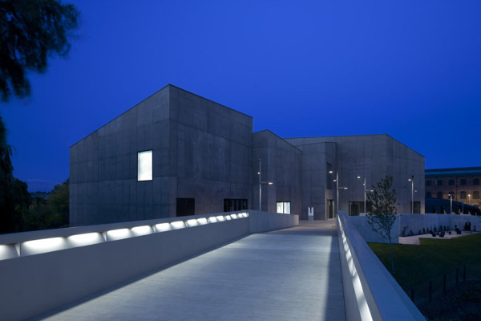
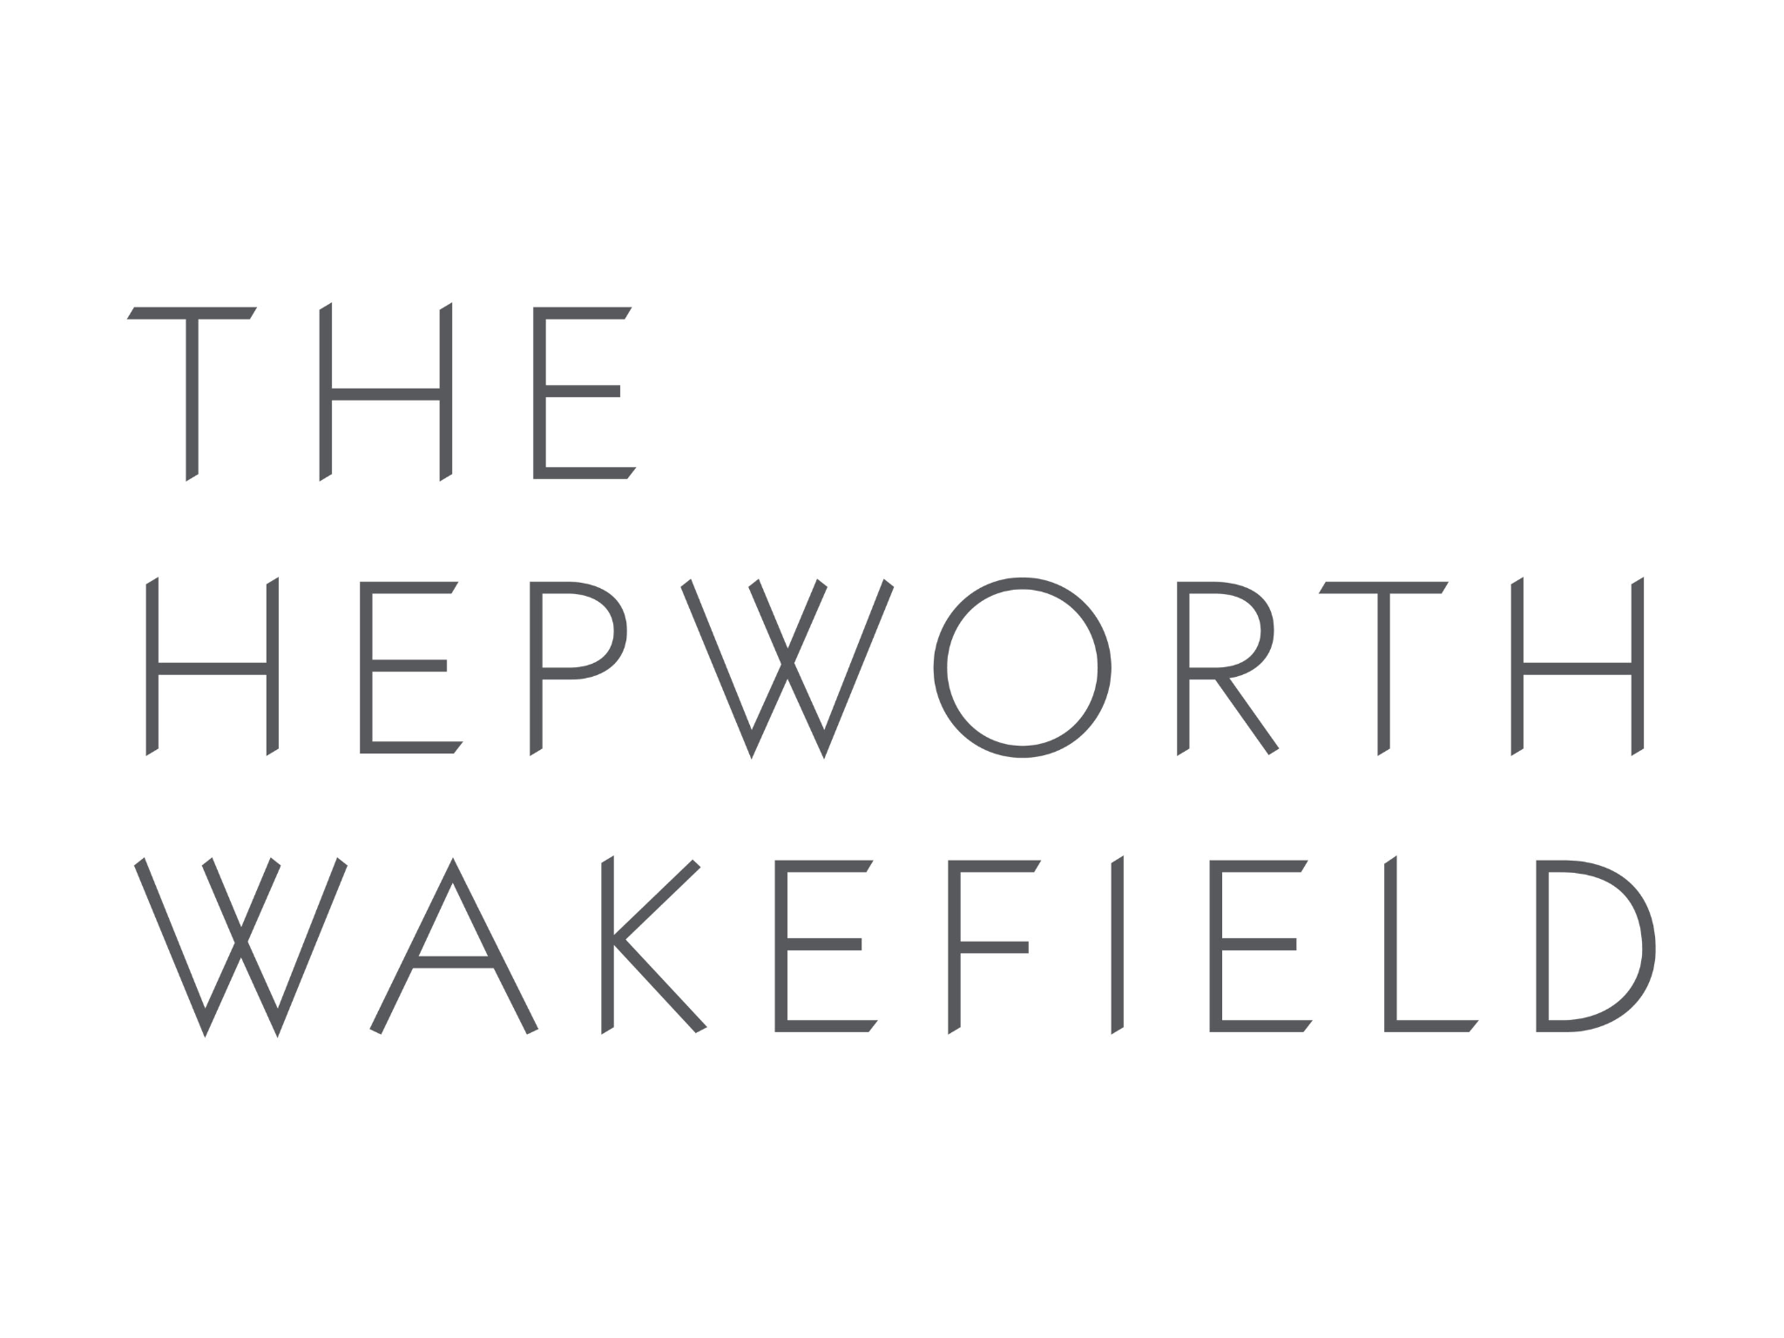
Museum AI Unlocking Collections National Cultural Infrastructure
JESSE JAMES AGENCY

Slide 19
JESSE JAMES AGENCY
Jesse James Agency Creative Director & Founder jesse@jessejamesagency.com

Slide 20
JESSE JAMES AGENCY
Linear to streaming Advertising to subscription Screens to no-screens Search to AI

Slide 21
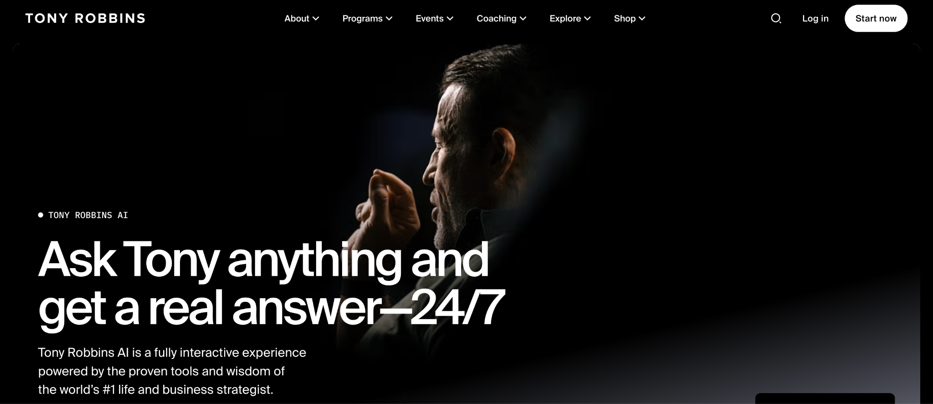

Slide 22
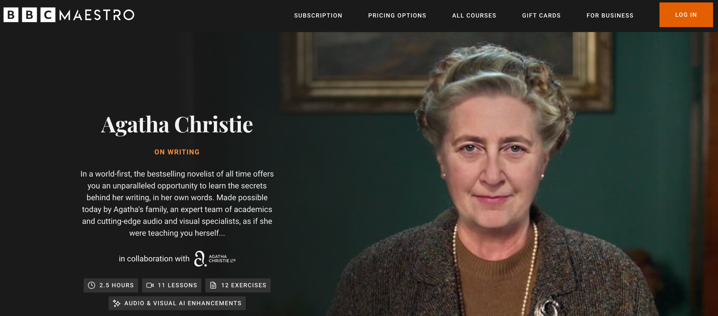

Slide 23
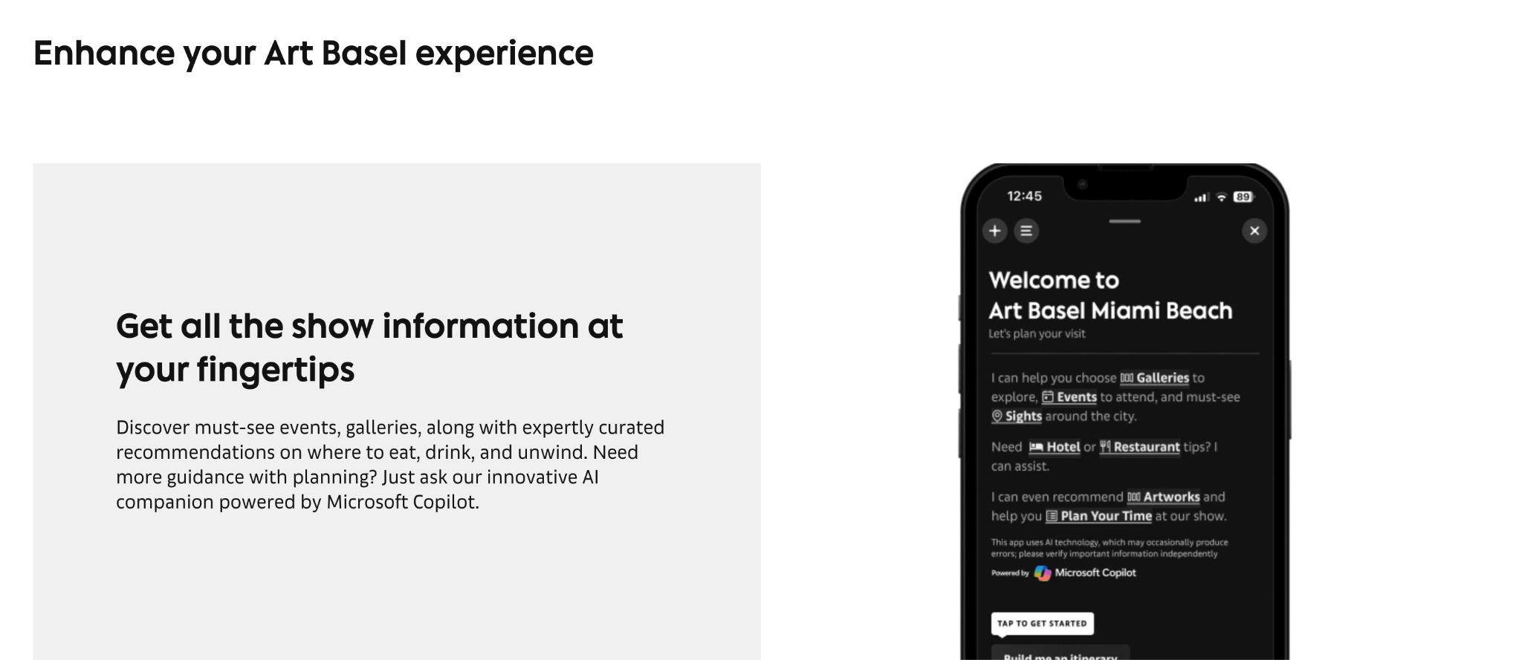
JESSE JAMES AGENCY

Slide 24
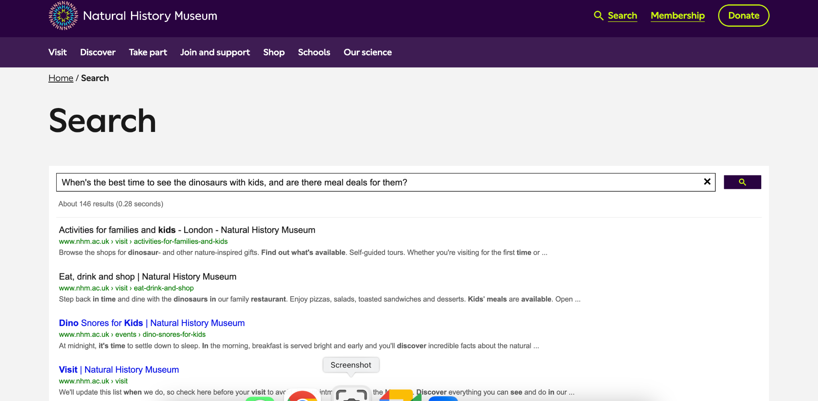

Slide 25
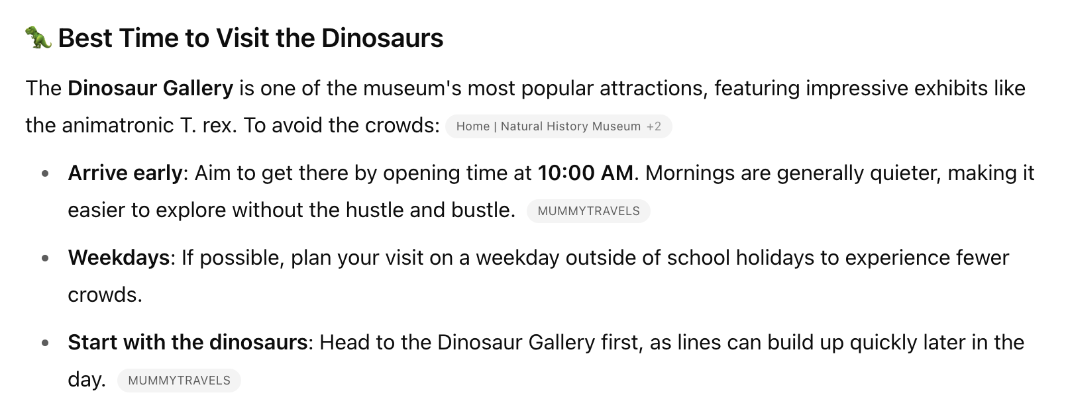
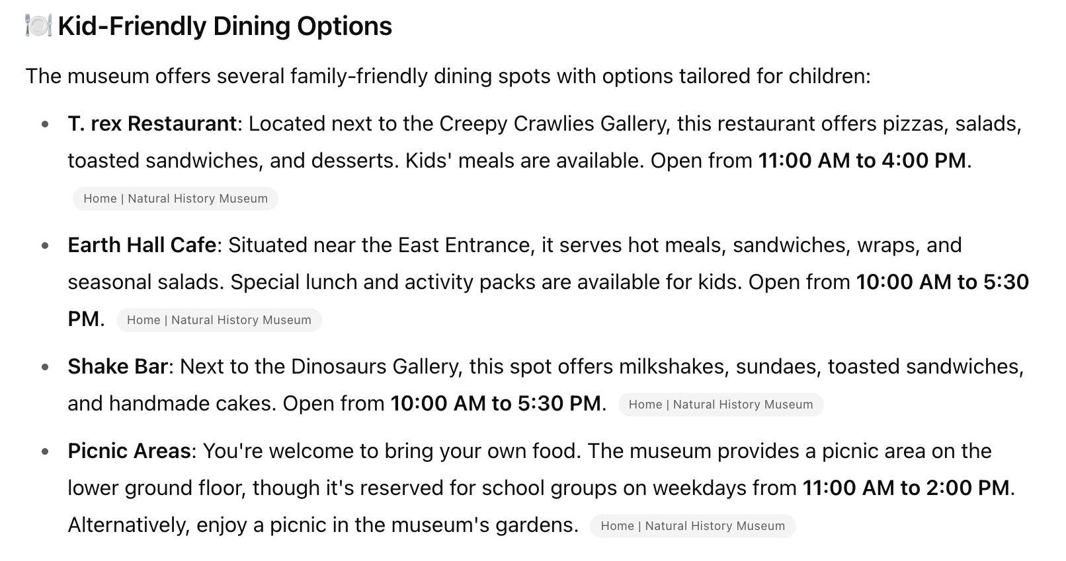
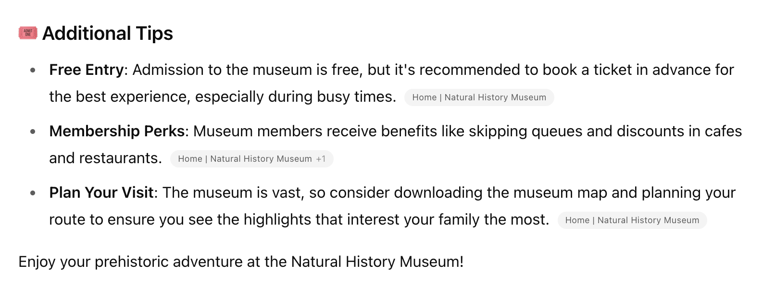
JESSE JAMES AGENCY

Slide 26
JESSE JAMES AGENCY
HEPWORTH AI The Hepworth Wakefield will launch a dedicated AI-powered assistant, transforming how audiences engage with art, knowledge, and the visitor experience.
“The first Museum AI Assistant powered by a Large Language Model (LLM) using Retrieval-Augmented Generation (RAG) on Hepworth’s proprietary data.”

Slide 27
JESSE JAMES AGENCY
AI vs Traditional Experience
Visitor: From outdated links → to instant family-friendly tips + upsell
Researcher: From irrelevant results → to hidden archives surfaced smartly
The world’s first Museum AI Assistant - it learns and grows
24/7 visitor engagement: exhibitions, collections, tickets, access, events, food
Trained exclusively on Hepworth-approved content
Instant, accurate, friendly answers - always on brand
Real-time insight into visitor interests and behaviour

Slide 28
JESSE JAMES AGENCY
What is Museum AI?
A sector-wide initiative to build museum AI Agents
Transforms public access, visitor experience, and audience insight
Trained only on institution-approved content
Ethical, trusted, inclusive – not a commercial overlay

Slide 29
JESSE JAMES AGENCY
What Museum AI Does
24/7 visitor and researcher engagement
Conversational and speech-based access
Fully controlled and curated content
High accuracy and relevance

Slide 30
JESSE JAMES AGENCY
Unlocking Collections
AI trained on curated, copyrighted materials
Surfaces buried stories, documents, and objects
Deepens public and academic engagement

Slide 31
JESSE JAMES AGENCY
Driving Insight and Growth
Real-time Data for Strategy:
Dashboards tracking public questions
Understanding public and research needs
Informs smarter programming and marketing

Slide 32
JESSE JAMES AGENCY
A National Platform
Connected.
Standalone platform linking museum agents
Ask by theme, period, artist, medium
Maintains attribution and provenance

Slide 33
JESSE JAMES AGENCY
Why Now?
A Shift in Discovery Behaviour:
AI is replacing search and SEO
Museum AI ensures trust, ownership, and provenance
Institutions retain curatorial authority

Slide 34
JESSE JAMES AGENCY
Why Not OpenAI?
The Case for Sector Ownership:
Commercial platforms lack provenance or ethics
Museum AI:
Owns training data + TRUST + cost control
Provides transparent responses + links
Accuracy + attribution + provenance + curatorial control

Slide 35
JESSE JAMES AGENCY
Timeline
Phase 1 - Local AI Assistants
Embedded on each museum’s site
Custom interface and tone
Voice and text support
Phase 2 - National Platform
Cross-museum discovery
Linked content and attribution
Shared metadata and standards

Slide 36
JESSE JAMES AGENCY
Pilot Institutions + Collaboration:
The Hepworth Wakefield (pilot) - applying for funding
Science Museum Group, V&A, The London Museum - proposing
Who wants to partner?

Slide 37
JESSE JAMES AGENCY
What This Delivers:
One search across UK museums
Boosts visibility for smaller institutions
Real audience insights for national impact
Museums retain autonomy + identity

Slide 38
JESSE JAMES AGENCY
Transforming Digital Engagement:
Static websites → Dynamic AI interfaces
Siloed catalogues → Interoperable discovery
Inaccessible archives → Spoken-word search
Institutional isolation, specifically collection → Sector collaboration

Slide 40
Museum AI Unlocking Collections National Cultural Infrastructure
JESSE JAMES AGENCY

Slide 41
JESSE JAMES AGENCY
Jesse James Agency Creative Director & Founder jesse@jessejamesagency.com

Slide 42
Q&A

